Slide 1


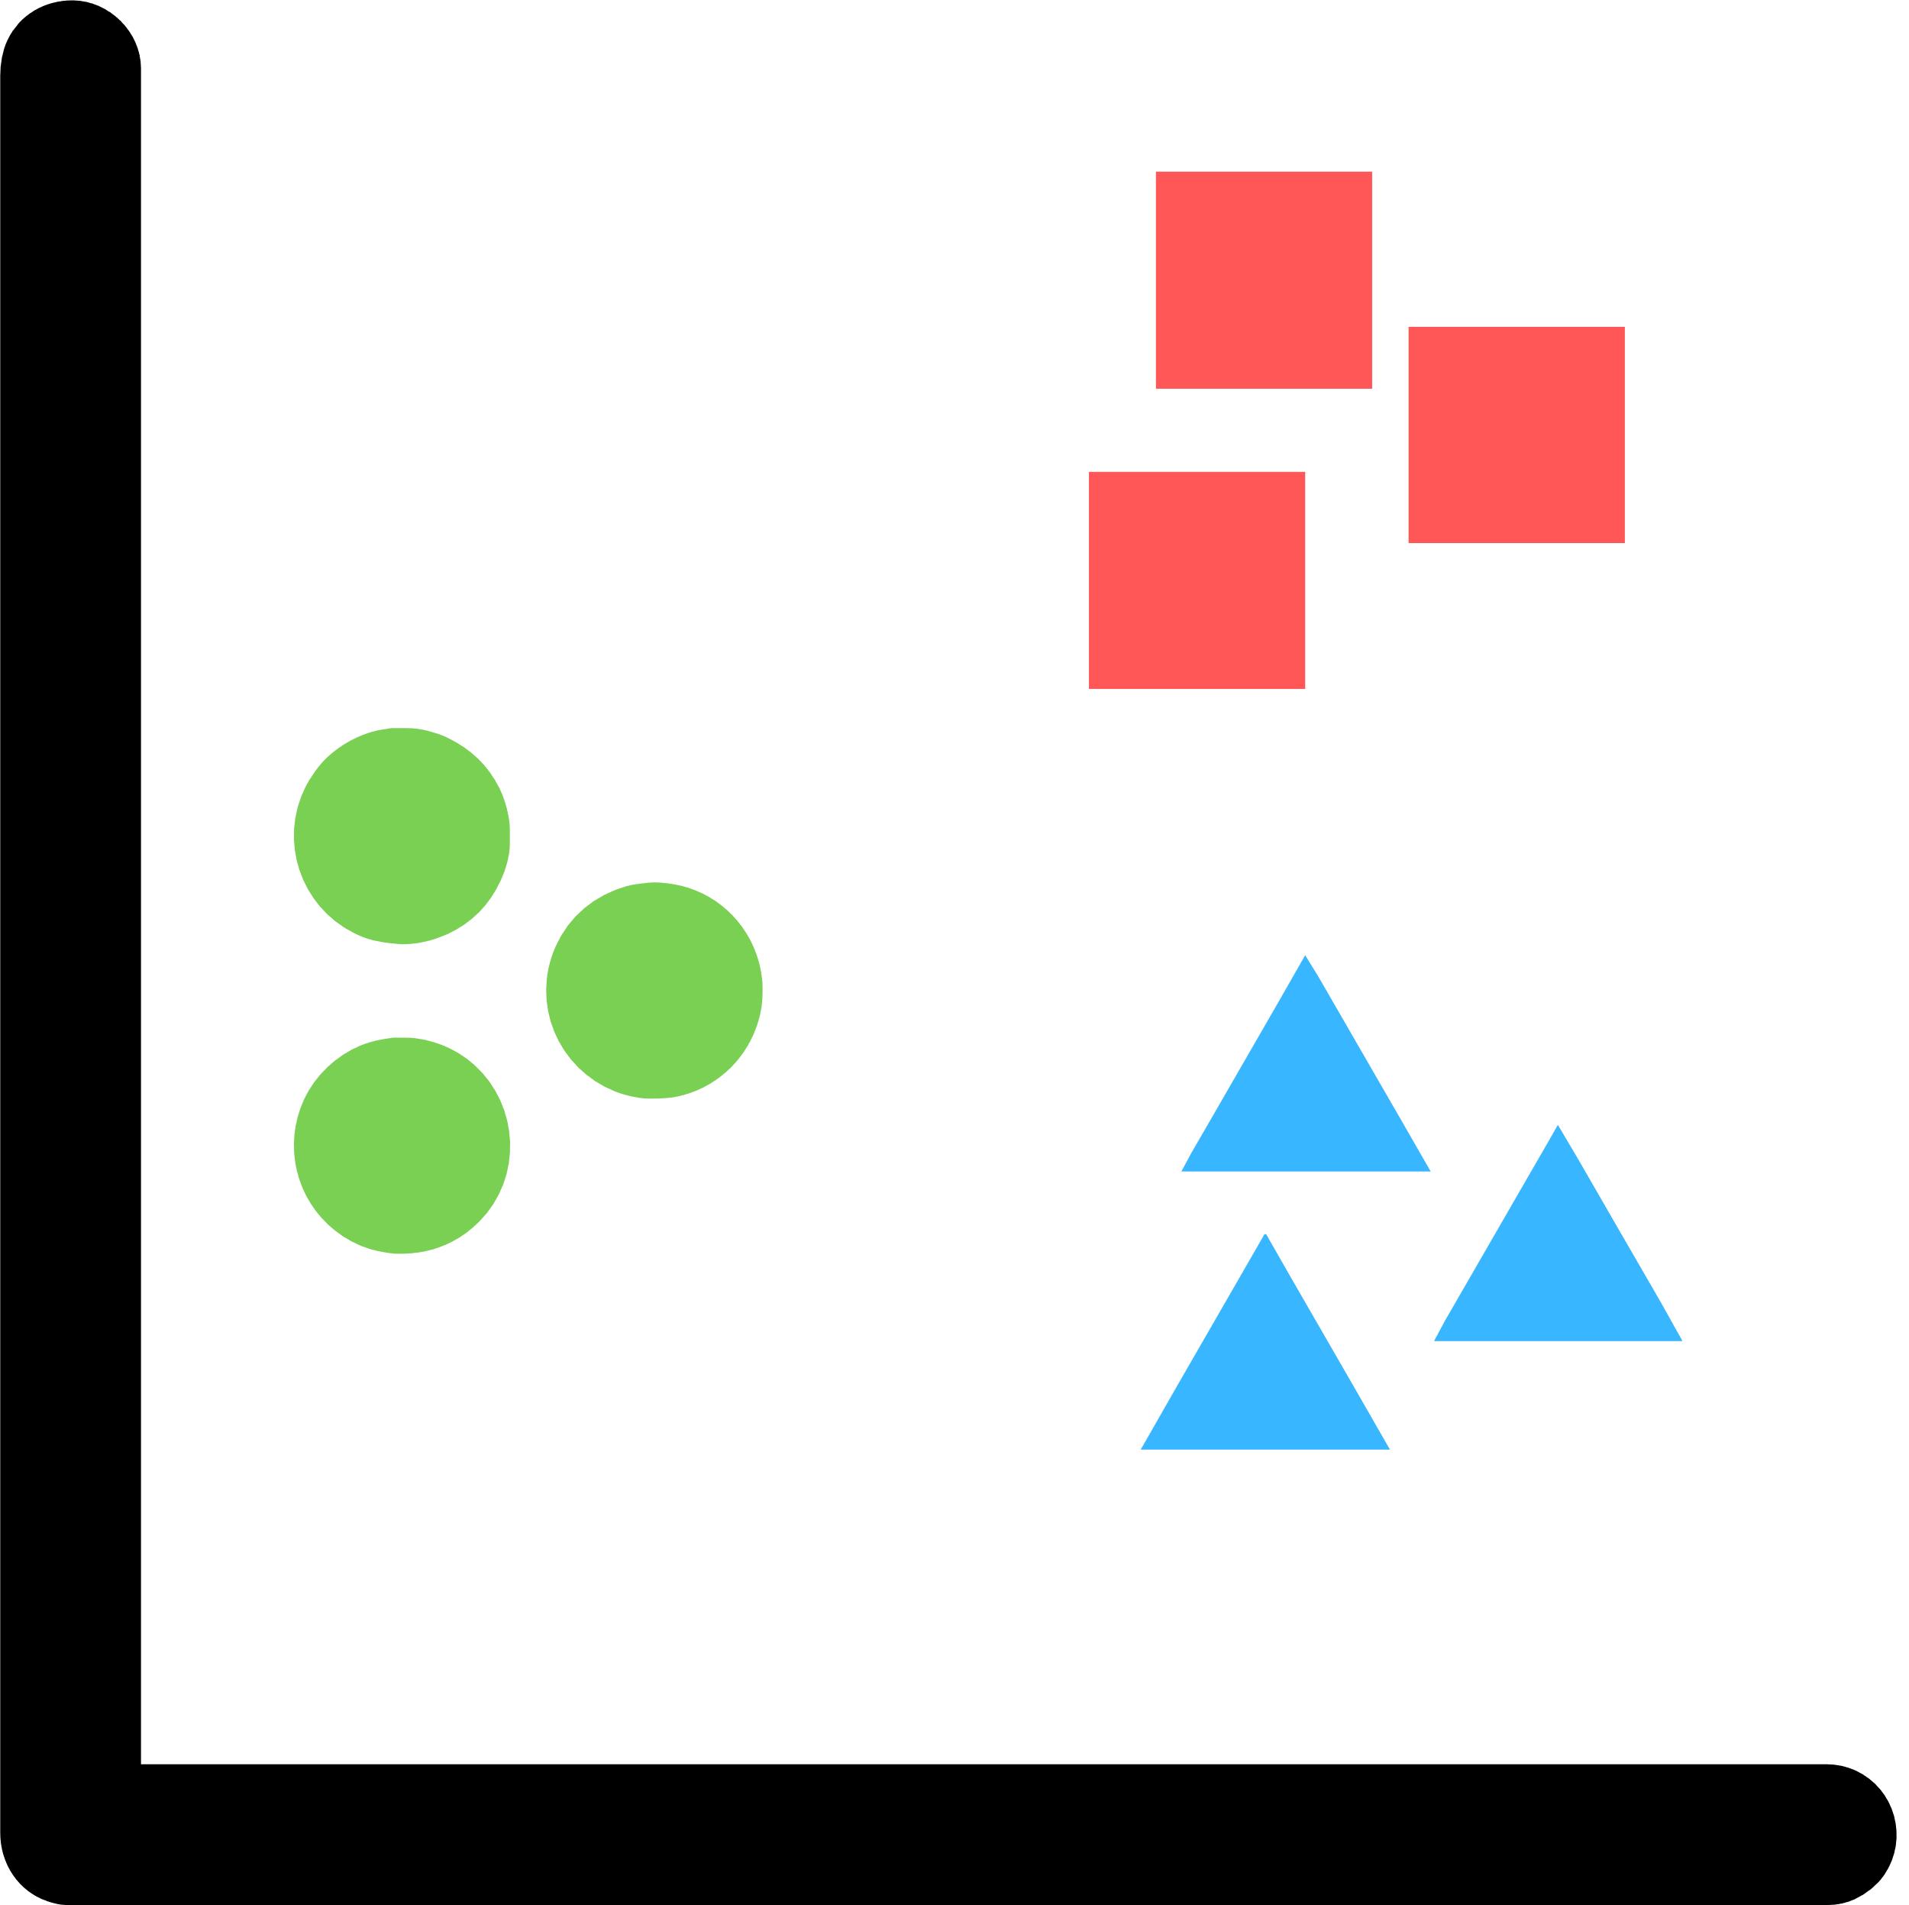

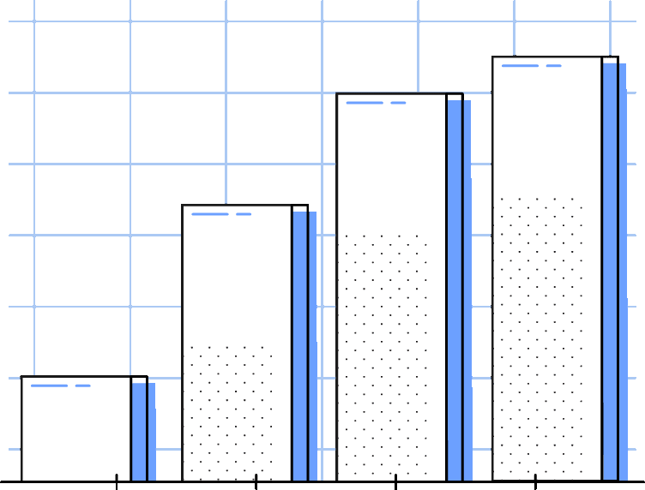
CPE - Team 4
SKIN CANCER DETECTION
Group Members: Aakanksha Patil
Vanshika Nair
Harsh Dankhara

Slide 2
INTRODUCTION
Skin cancer is one of the most frequent cancers not only in the United States but also worldwide, with about 10,000 people diagnosed with it in the United States every day. Despite the fact that the number of Melanoma deaths is expected to rise by 22% in the coming year, early identification of the disease can lead to a 99% survival rate.
Early detection of skin cancer is critical and can prevent further spread in some cases, such as melanoma and focal cell carcinoma. In any case, there are several factors that have a negative impact on detection accuracy. In recent years, the use of image processing and computer vision in healthcare and medical applications has increased significantly.
In this study, we use various machine learning models to detect and categorize cancer based on dermatoscopic images of pigmented lesions.

Slide 3
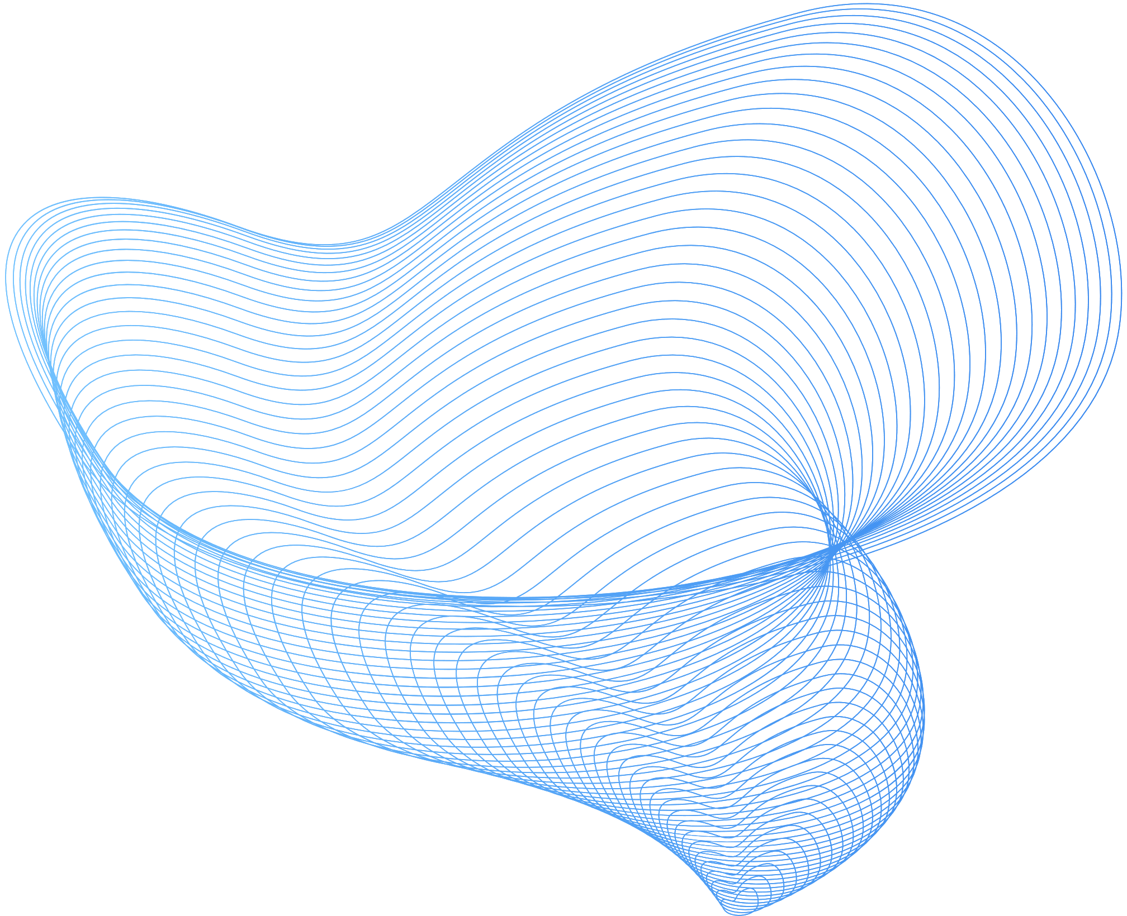
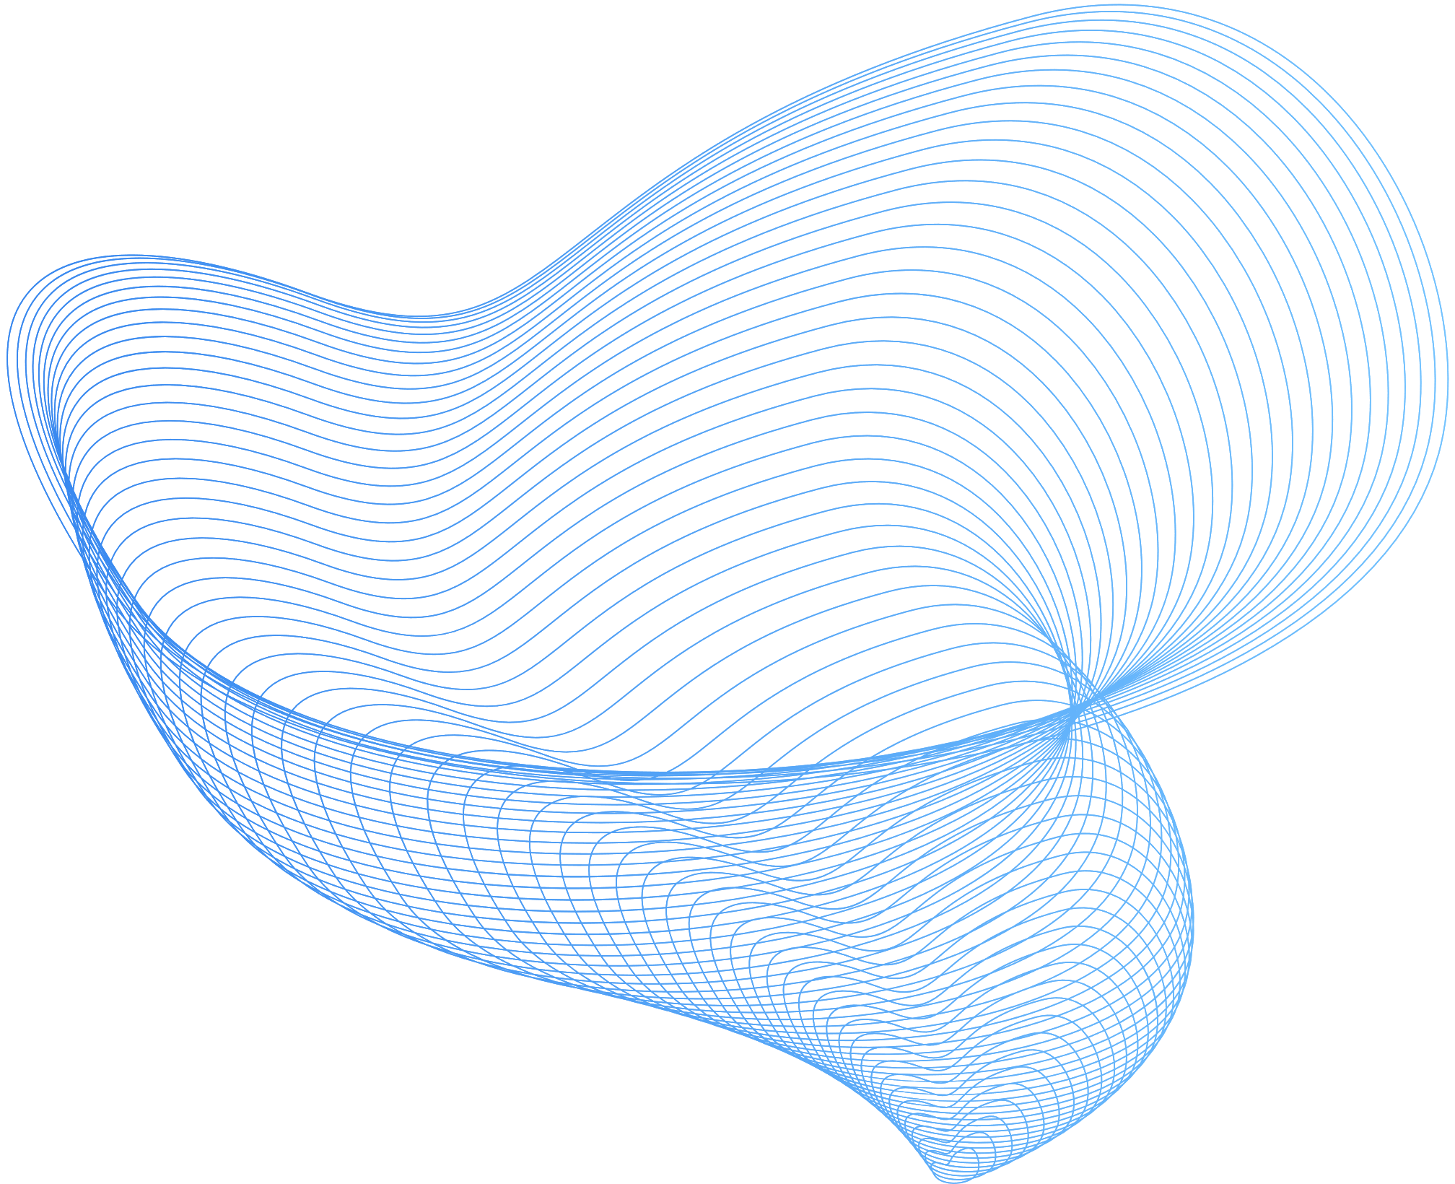

DESCRIPTION OF THE DATASET
The study of skin disease analysis focuses primarily on the main causes and factors that have a serious impact on health.
We used the dataset and the images from Kaggle.
The dataset contains:
A .csv file that contains information about the patient
the image_id of the probable cancer-causing mole.
age of the patient
sex of the patient
location of the mole
Two folders with images of the probable cancerous mole
This dataset is a large collection of multi-sources dermatoscopic images of pigmented lesions from different populations, acquired and stored by different modalities. The final dataset consists of 10015 dermatoscopic images which can serve as a training set for our project.

Slide 4
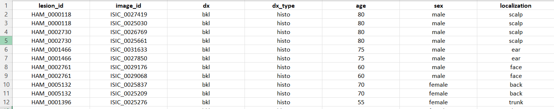
.csv file from the dataset
Notice that column dx provides us with the abbreviations for each type of skin cancer. There are a total of seven types that we aim to classify in this project. The seven types are:
Melanocytic nevi (nv)
Melanoma (mel)
Benign keratosis-like lesions (bkl)
Basal cell carcinoma (bcc)
Actinic keratoses (akiec)
Vascular lesions (vas)
Dermatofibroma (df)

Slide 5
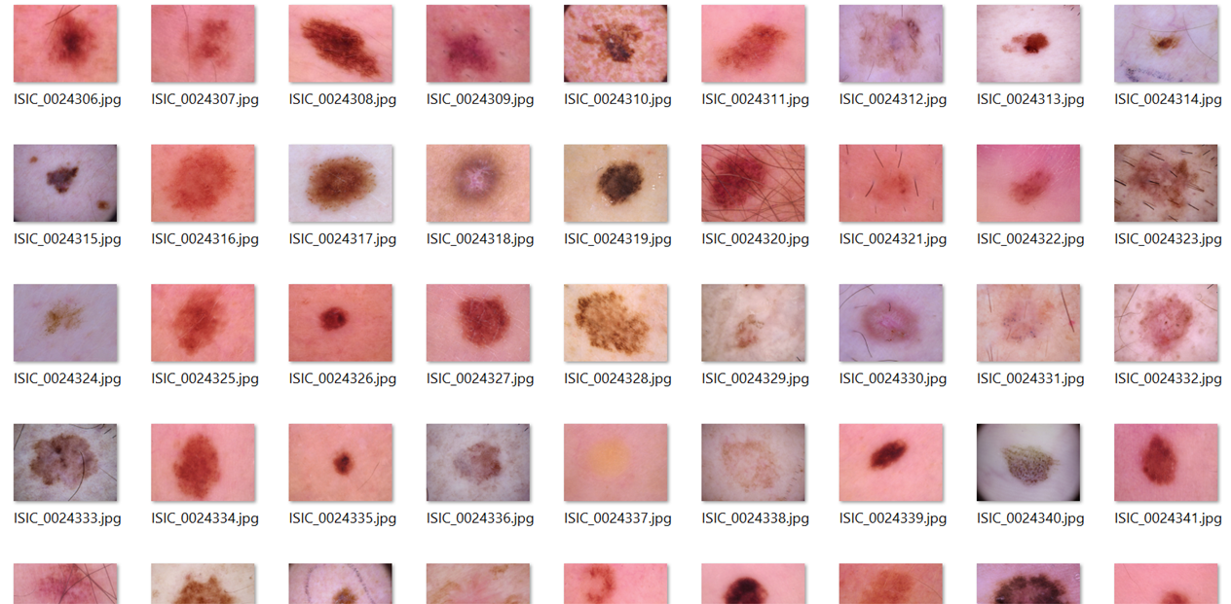
This is a snipet of the folder with all the images

Slide 6
DATA PREPROCESSING
We offer our deep learning model extra information to learn from by producing several copies of our images in different orientations without having to go through the time-consuming process of gathering and labeling new training data.
Resizing of Images
Rotating the images
01.
03.
Image resizing is an important pre-processing step in computer vision. Deep learning models, in general, train quicker on tiny pictures.
The network must predict the rotation angle of the images, which may help the model to predict the type more efficiently
Reducing the dimensions
Flipping the images
02.
04.
Reducing the dimensionality of the data allows the model to be more generic while also improving performance and accuracy on unknown data.
This reversal of orientation is referred to as flipping a picture. We have flipped our images horizontally and vertically.

Slide 7
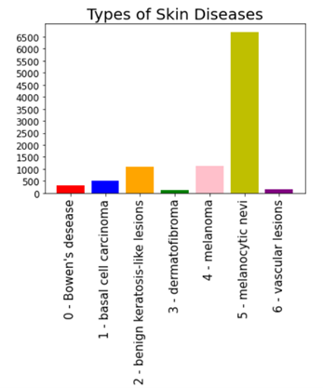
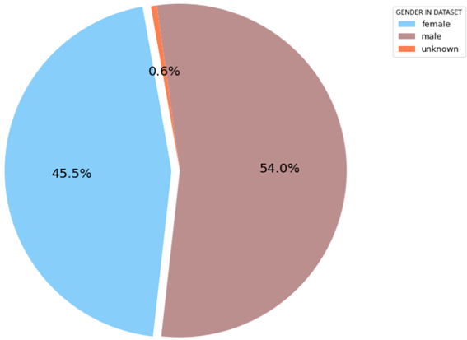
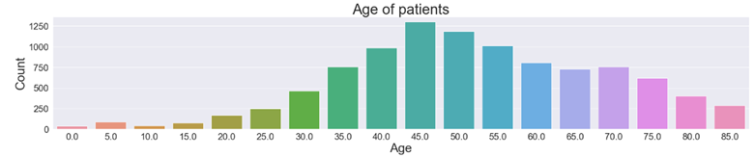
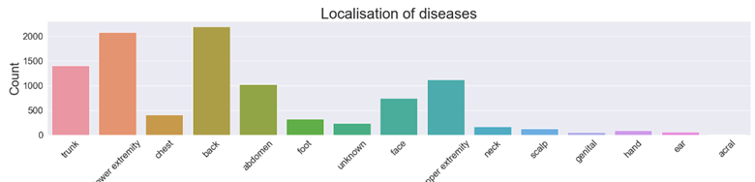
DATA VISUALIZATION
Ratio of male vs female patients
Count of different types of skin diseases in the dataset
Distribution of age of patients
Localization of of the cancer in the body

Slide 8
MACHINE LEARNING ALGORITHMS
To serve the purpose of the project we have implemented two supervised machine learning algorithms and one neural network.
01.
02.
03.
Support Vector Machine
Random Forest
Convolution Neural Network
Support vector machines are useful because they can handle a variety of continuous and categorical data. Additionally, it produces multidimensional space to divide various classes and iteratively builds the best hyperplane, minimizing error
We chose random forest because it provides estimates for feature relevance and can handle enormous data with thousands of variables by automatically balancing data sets when one class is more rare than others in the data.
We used CNN because they are exceptionally good at lowering the number of parameters without sacrificing model quality. Images contain a great degree of dimension since each pixel is treated as a feature, which is ideal for CNNs’ abilities as explained above.

Slide 9
IMPLEMENTATION
The data set has been divided into training and testing data sets, each of which is 80 and 20 percent of the original data set. The training data set is used to develop the models, while the testing data set is used to make predictions. Our results for both algorithm’s accuracy were 66.95% and 72.24%, respectively. And thus we made the decision to improve the Random Forest algorithm’s performance. In order to increase accuracy, we performed hyperparameter tuning and obtained the values for the parameters max depth, n estimators, min samples leaf, and min samples split using GridSearchCV that gave us the highest accuracy. We then trained the classifier once more using these values as input, but we were unable to detect any improvement in accuracy.
First, we used ImageDataGenerator to rotate, resize, shift the image’s height and width, and flip it hori?zontally and vertically. Next, we normalized the array so that everything is between 0 and 1. We utilized 4 convolutional and max pooling layers to train the model. In order to extract features from the input image, a convolution layer alters it. This transformation involves convolving the image with a kernel (or filter). As a result, it lessens the quantity of network computation and the number of parameters that must be learned.

Slide 10
IMPLEMENTATION (CONTINUED)
In order to give the model’s convolution layers the property of nonlinearity and resolve the vanishing problem, we applied the activation function Relu. We have kept the padding type as SAME since the output size is the same as the input size. If it receives any negative input, it returns 0, but if it receives any positive input, it returns that value. We then employ three dense layers, with the number of hidden layers decreasing from 64 to 32 to 7 in order to categorize the seven different forms of skin cancer. Relu was utilized as the activation function for the first two dense layers, and Softmax was used for the final layer since it gives each class in a multi-class problem a decimal probability. As our optimization approach for iteratively updating the weights, we employed adam. We utilized the EarlyStopping Method to train the data since it allows you to specify an arbitrarily large number of training epochs and stop training when the model performance on a hold-out validation dataset stops increasing. We have utilized K-fold cross-validation, which divides the dataset into K folds and assesses the model’s performance when faced with fresh data. Finally, we were able to extract the multiclass confusion matrix, from which we were able to calculate the accuracy score, which was quite high—about 97.91%—and was roughly 20% higher than the machine learning algorithms that we used.

Slide 11

SKIN CANCER IMAGES
(DATASET)
PRE-PROCESSING: NOISE REMOVAL, SEGMENTATION
FEATURE EXTRACTION
CNN ARCHITECTURE CLASSIFICATION

Slide 12
CONCLUSION
We can observe from the accuracy scores of these machine learning algorithms that they are not efficient, and we are also unable to increase performance using methods like hyper parameter tuning. Convolution neural networks from deep learning models will be used in subsequent tests because they are exceptionally good at lowering the amount of parameters without sacrificing model quality. Images contain a great degree of dimension since each pixel is treated as a feature, which is ideal for CNNs’ abilities as explained above. We are not yet finished, thus we are unable to offer a thorough conclusion.

Slide 13
THANKYOU !

